Slide 1
Data Mining:
Concepts and Techniques
(3rd ed.)
— Chapter 3 —
Jiawei Han, Micheline Kamber, and Jian Pei
University of Illinois at Urbana-Champaign &
Simon Fraser University
©2011 Han, Kamber & Pei. All rights reserved.

Slide 2
Chapter 3: Data Preprocessing
Data Preprocessing: An Overview
  Data Quality
  Major Tasks in Data Preprocessing
Data Cleaning
Data Integration
Data Reduction
Data Transformation and Data Discretization
Summary

Slide 3
Data Quality: Why Preprocess the Data?
Preprocessing data is a critical step in any data science or machine learning project.
Raw data is often incomplete, inconsistent, noisy, or irrelevant, and must be cleaned and transformed before it can be effectively used.

Slide 4
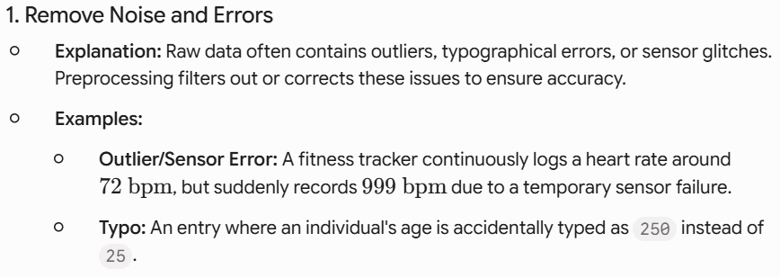

Data Quality: Why Preprocess the Data?

Slide 5
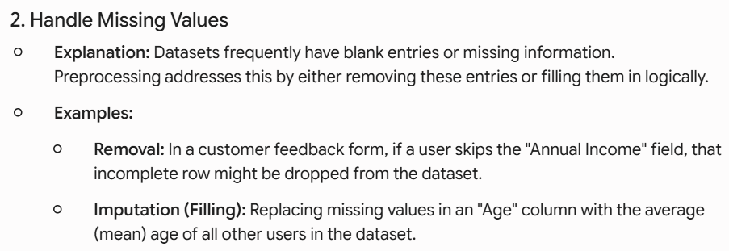
Data Quality: Why Preprocess the Data?

Slide 6
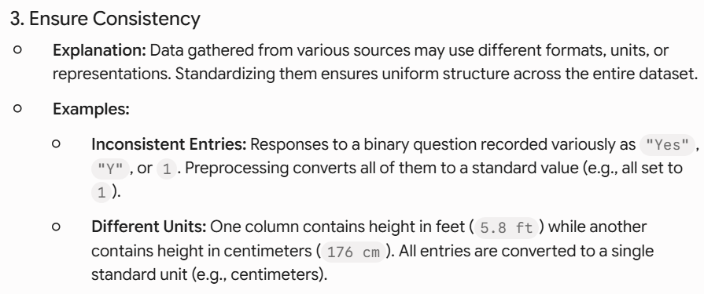
Data Quality: Why Preprocess the Data?

Slide 7
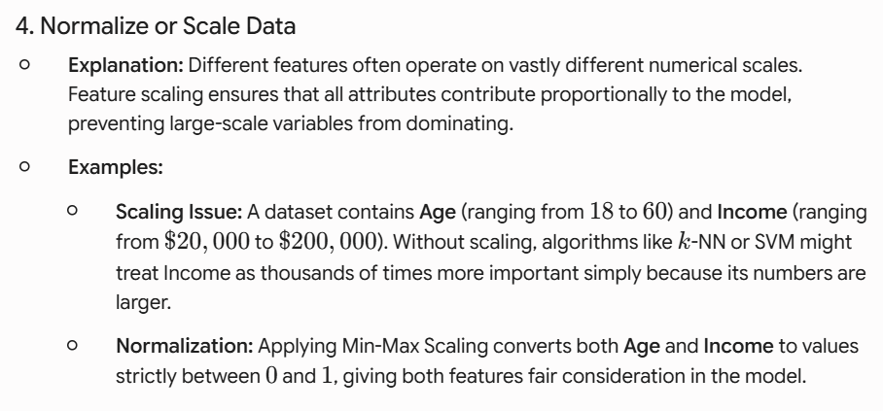
Data Quality: Why Preprocess the Data?

Slide 8
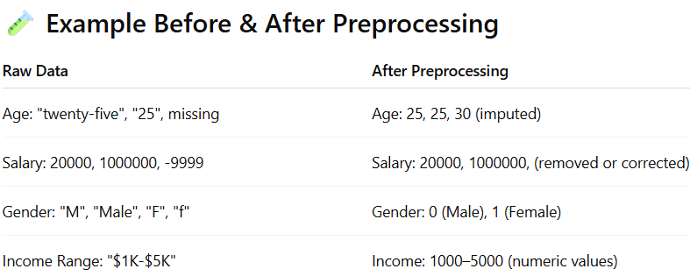
Data Quality: Why Preprocess the Data?

Slide 9
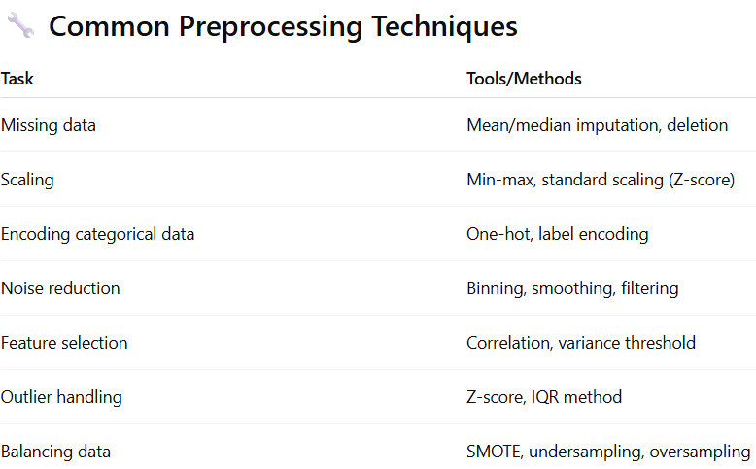
Data Quality: Why Preprocess the Data?

Slide 10
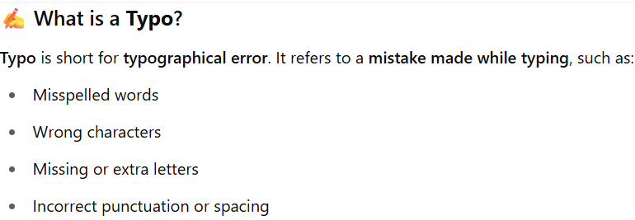
Misspelled Words | Words spelled incorrectly while typing. | Writing Macheen instead of Machine.
Wrong Characters | Pressing the wrong adjacent key on the keyboard. | Typing Hellp instead of Hello.
Missing / Extra Letters | Accidentally dropping or adding characters. | Typing Data Scince (missing 'e') or Gooood (extra 'o').
Incorrect Punctuation / Spacing | Wrong space or punctuation mark placement. | Typing DataPreprocessing (missing space) or Hello. World?

Slide 11
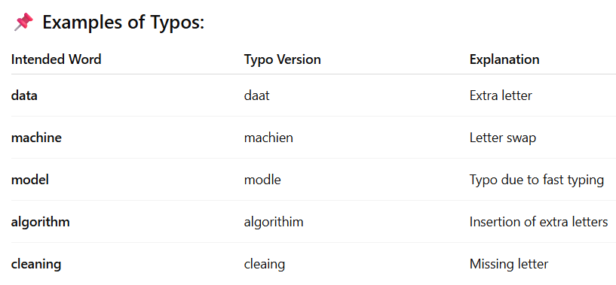

Slide 12
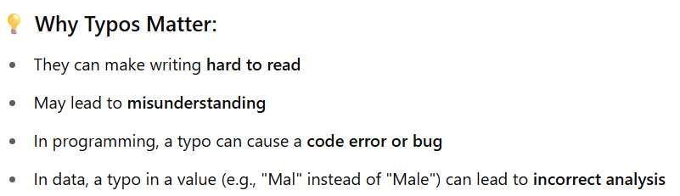
Spell-checkers and auto-correct tools in word processors or phones are designed to catch and fix typos.

Slide 13
Major Tasks in Data Preprocessing
Data cleaning
Data integration
Data reduction
Data transformation and
Data discretization

Slide 14
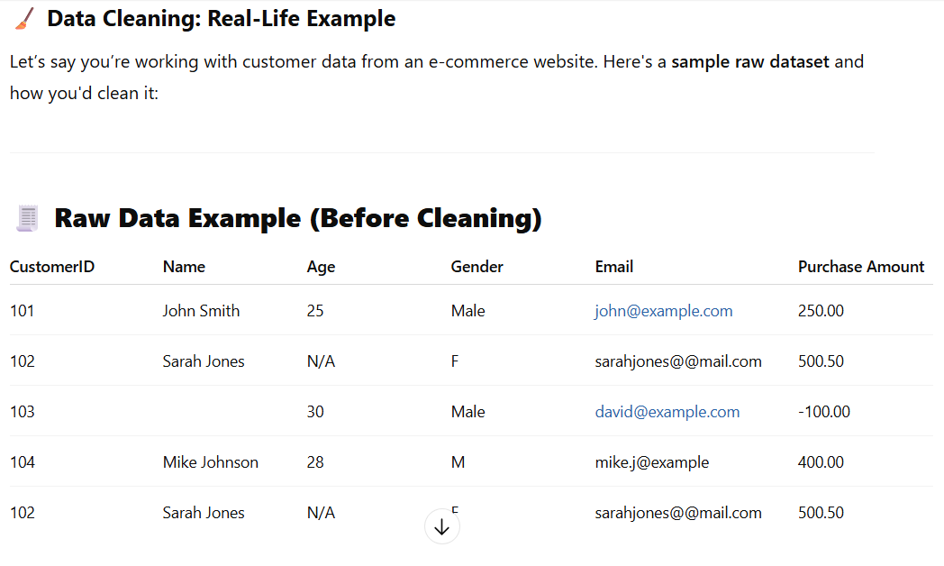
Data cleaning

Slide 15
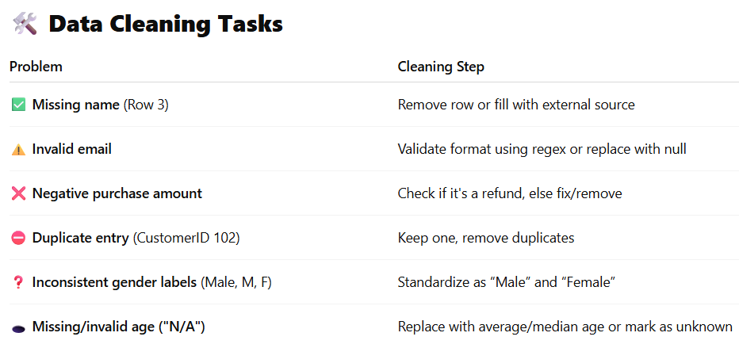
Data cleaning

Slide 16
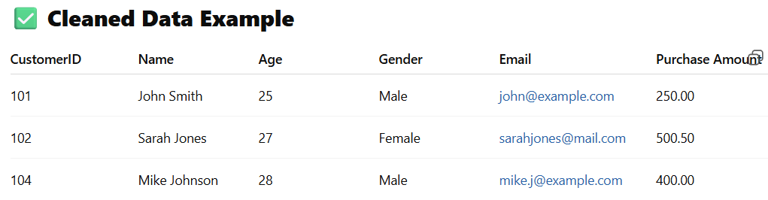
Data cleaning

Slide 17
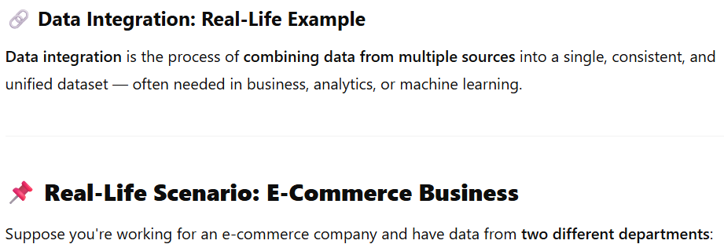
Data integration

Slide 18
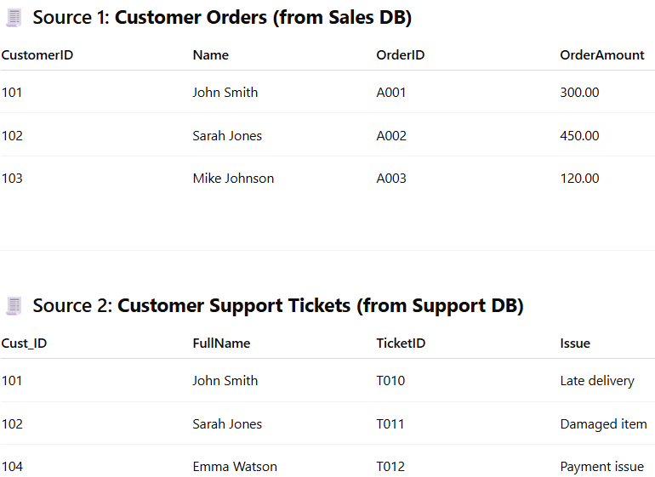
Data integration

Slide 19
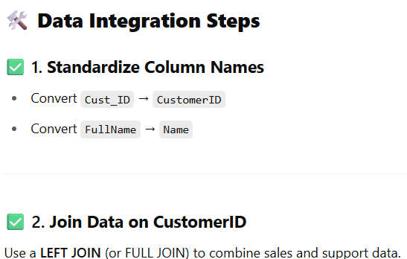
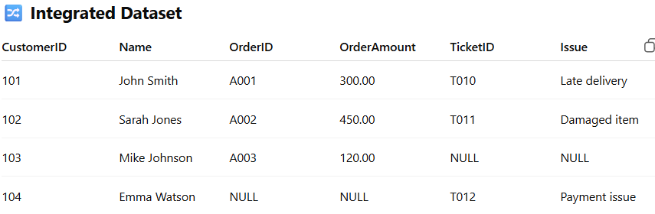
Data integration

Slide 20
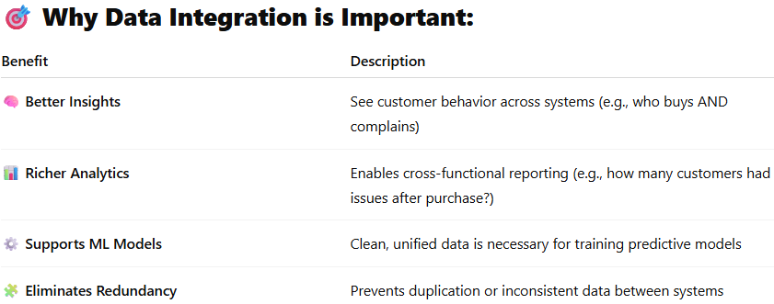
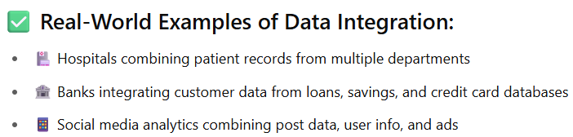
Data integration

Slide 21
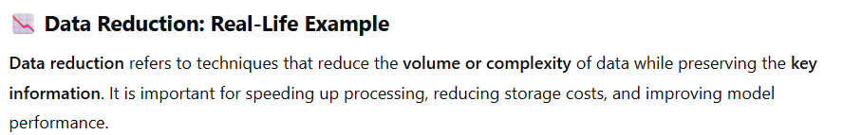
Data reduction real example

Slide 22
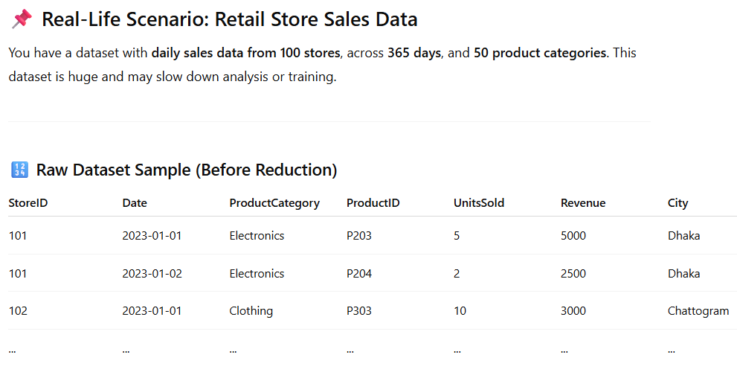
Data reduction real example

Slide 23
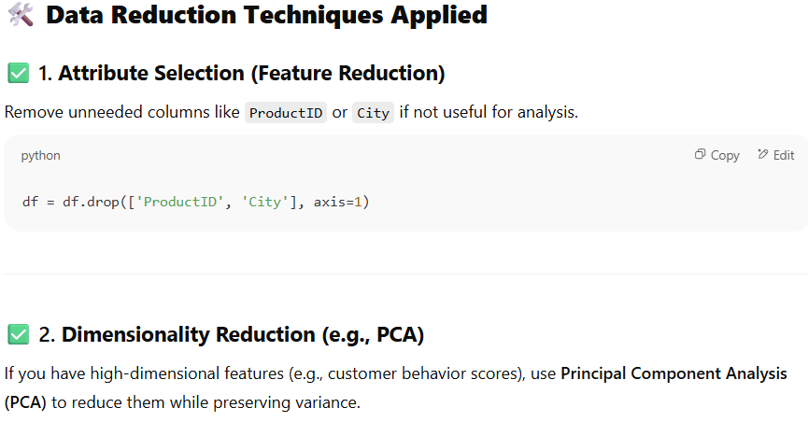
Data reduction real example

Slide 24
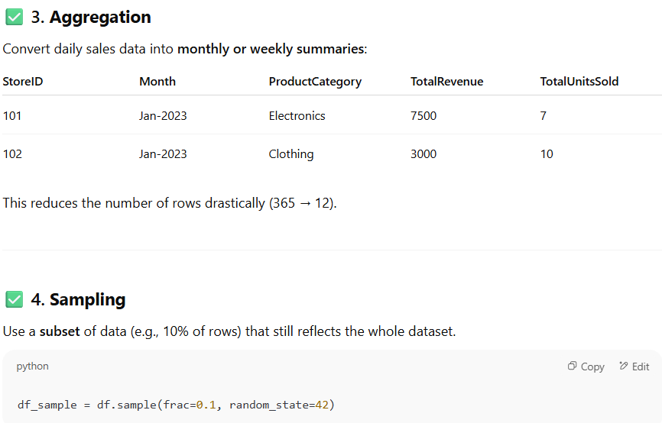
Data reduction real example

Slide 25
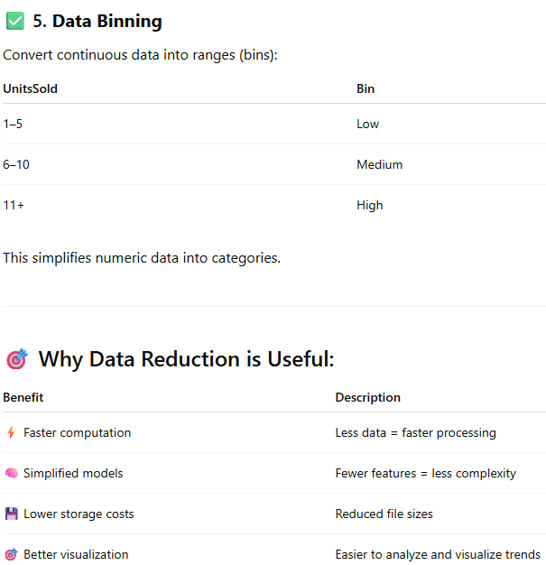
Data reduction real example

Slide 26
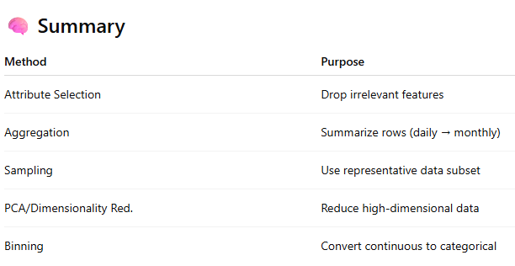
Data reduction real example

Slide 27
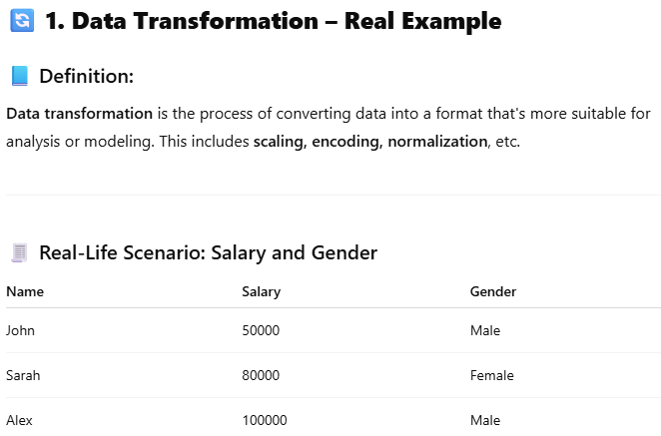

Slide 28
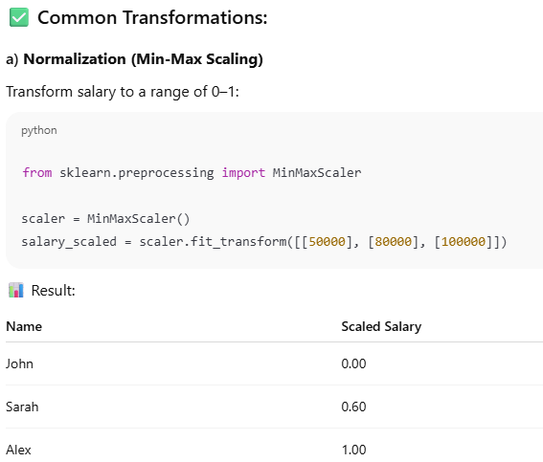
Data Transformation – Real Example

Slide 29
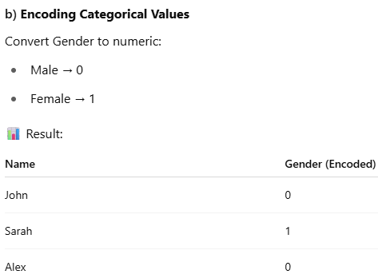
Data Transformation – Real Example

Slide 30
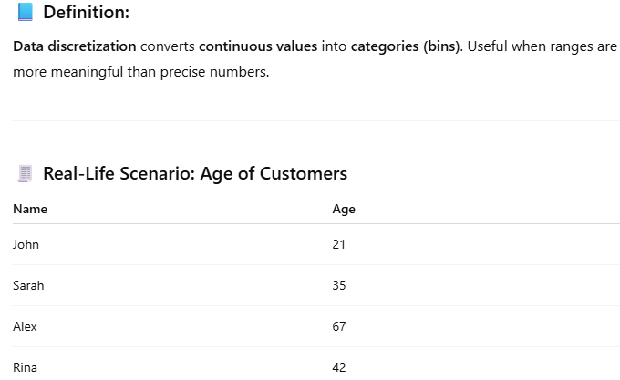
Data Discretization – Real Example

Slide 31
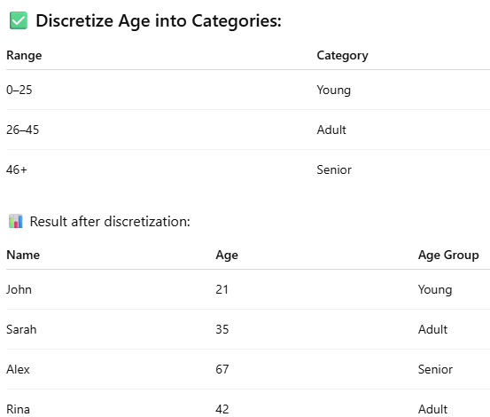
Data Discretization – Real Example

Slide 32
What is a data cube example?
A Data Cube is a multi-dimensional array of data, commonly used in
  data warehousing and OLAP (Online Analytical Processing) to help with
    fast, complex queries across multiple dimensions (like time, location, product, etc.).

Slide 33
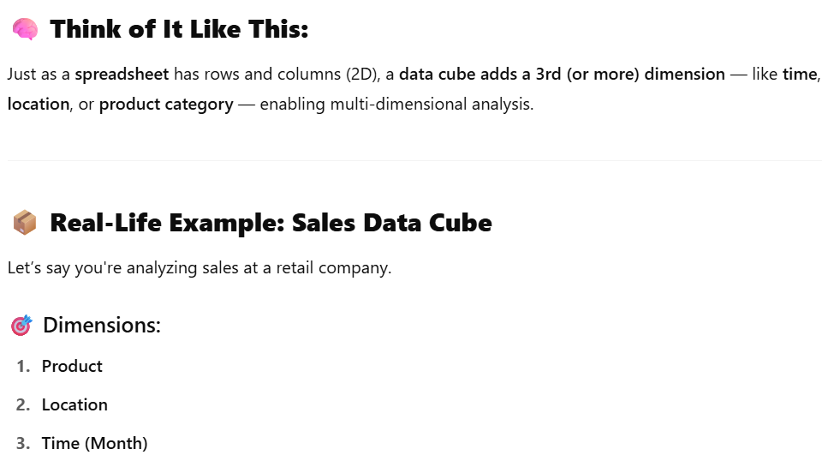
What is a data cube example?

Slide 34
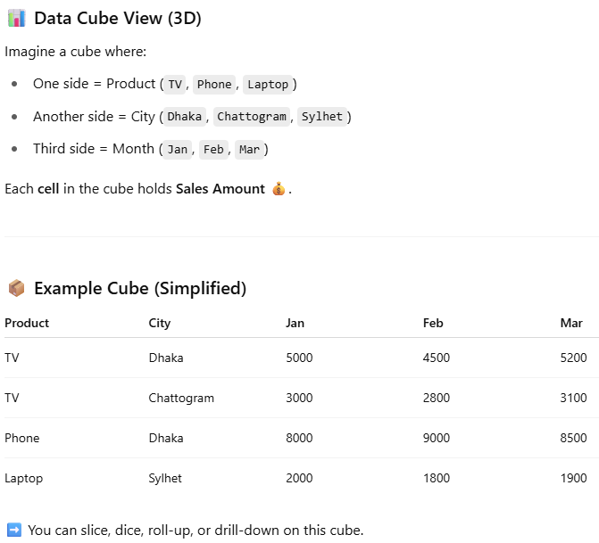
What is a data cube example?

Slide 35
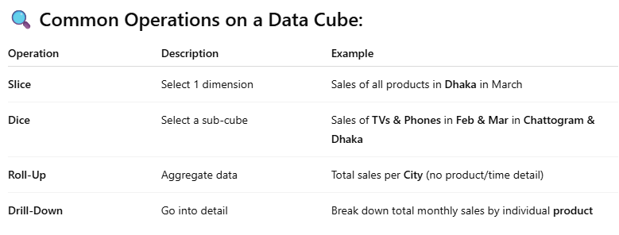
What is a data cube example?

Slide 36
Chapter 3: Data Preprocessing
Data Preprocessing: An Overview
  Data Quality
  Major Tasks in Data Preprocessing
Data Cleaning
Data Integration
Data Reduction
Data Transformation and Data Discretization
Summary

Slide 37
Data Cleaning
Data in the Real World Is Dirty: Lots of potentially incorrect data, e.g., instrument faulty, human or computer error, transmission error
  incomplete: lacking attribute values, lacking certain attributes of interest, or containing only aggregate data
    e.g., Occupation=“ ” (missing data)
  noisy: containing noise, errors, or outliers
    e.g., Salary=“−10” (an error)
  inconsistent: containing discrepancies (lack of compatibility or similarity between two or more facts) in codes or names, e.g.,
    Age=“42”, Birthday=“03/07/2010”
    Was rating “1, 2, 3”, now rating “A, B, C”
discrepancy অসামজ্ঞ্জস্য between duplicate records
  Intentional (e.g., disguised missing data)
    Jan. 1 as everyone’s birthday?

Slide 38
Incomplete (Missing) Data
Data is not always available
  E.g., many tuples have no recorded value for several attributes, such as customer income in sales data
Missing data may be due to
  equipment malfunction
  inconsistent with other recorded data and thus deleted
  data not entered due to misunderstanding
  certain data may not be considered important at the time of entry
  not register history or changes of the data
Missing data may need to be inferred (অনুমান করা)

Slide 39
How to Handle Missing Data?
Ignore the tuple: usually done when class label is missing (when doing classification)
  This method is not very effective, unless the tuple contains several attributes with missing values.
Fill in the missing value manually: tedious (ক্লান্তিকর)+infeasible?
Fill in it automatically with
  a global constant : e.g., “unknown”, a new class?!
  the attribute mean
the attribute mean for all samples belonging to the same class: e.g., replace the missing value with the mean income value for customers in the same
Credit risk category
  the most probable value: inference-based such as Bayesian formula or decision tree

Slide 40
Noisy Data
Noise: random error or variance in a measured variable
Incorrect attribute values may be due to
  faulty data collection instruments
  data entry problems
  data transmission problems
  technology limitation
  inconsistency in naming convention
Other data problems which require data cleaning
  duplicate records
  incomplete data
  Inconsistent (বেমানান) data

Slide 41
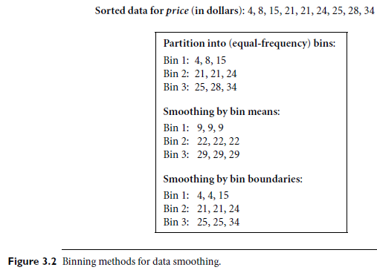
How to Handle Noisy Data?
replaced by the closest boundary value

Slide 42
How to Handle Noisy Data?
Binning
  first sort data and partition into (equal-frequency) bins
  then one can smooth by bin means, smooth by bin median, smooth by bin boundaries, etc.
Regression
  smooth by fitting the data into regression functions
Clustering
  detect and remove outliers
Combined computer and human inspection
  detect suspicious values and check by human (e.g., deal with possible outliers)

Slide 43
Data Cleaning as a Process
Data discrepancy (অমিল) detection-first step
  Can be caused by several factors,
    including poorly designed data entry forms that have many optional fields,
    human error in data entry,
    deliberate errors (e.g., respondents not wanting to disclose information about themselves), and
    data decay (e.g., outdated addresses)
There may also be inconsistencies due to data integration (e.g., where a given attribute can have different names in different databases-student ID/roll no)

Slide 44
--------------------------------

Slide 45
Data Cleaning as a Process
Use any knowledge you may already have regarding properties of the data. Such knowledge or “data about data” is referred to as metadata
  Use metadata (e.g., domain, range, dependency, distribution)
    what are the data type and domain of each attribute?
    What are the acceptable values for each attribute?
Basic statistical data descriptions are useful here to grasp data trends and identify anomalies.
For example,
  find the mean, median, and mode values.
  Are the data symmetric or skewed?
  What is the range of values?

Slide 46
Data Cleaning as a Process
  Do all values fall within the expected range?
  What is the standard deviation of each attribute?
  Values that are more than two standard deviations away from the mean for a given attribute may be flagged as potential outliers.
  Are there any known dependencies between attributes?
  From this, you may find noise, outliers, and unusual values that need investigation
As a data analyst, you should be on the lookout for the inconsistent use of codes and any inconsistent data representations (e.g., “2010/12/25” and “25/12/2010” for date).

Slide 47
Data Cleaning as a Process
  Check field overloading
    Field overloading is another error source that typically results when developers squeeze new attribute definitions into unused (bit) portions of already defined attributes (e.g., an unused bit of an attribute that has a value range that uses only, say, 31 out of 32 bits).
  Check uniqueness rule, consecutive rule and null rule
    A unique rule says that each value of the given attribute must be different from all other values for that attribute
    A consecutive rule says that there can be no missing values between the lowest and highest values for the attribute, and that all values must also be unique (e.g., as in check numbers).

Slide 48
Data Cleaning as a Process
  A null rule specifies the use of blanks, question marks, special characters, or other strings that may indicate the null condition (e.g., where a value for a given attribute is not available), and how such values should be handled.
Reasons for missing values may include
  (1) the person originally asked to provide a value for the attribute refuses and/or finds that the information requested is not applicable (e.g., a license number attribute left blank by nondrivers);
  (2) the data entry person does not know the correct value; or
  (3) The null rule should specify how to record the null condition,
    for example, such as to store zero for numeric attributes,
    a blank for character attributes, or any other conventions that may be in use (e.g., entries like “don’t know” or “?” should be transformed to blank).

Slide 49
Data auditing with real example
Data auditing is the process of examining datasets to assess their quality, integrity, structure, and consistency before applying any data preprocessing or modeling.
It’s a diagnostic step in the data wrangling workflow, often used to uncover issues like missing data, duplicates, outliers, or inconsistencies.

Slide 50
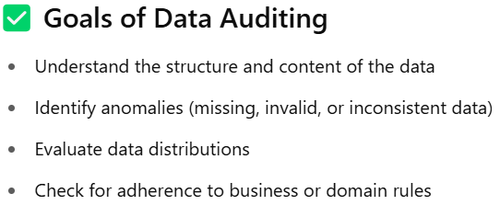
Data auditing with real example

Slide 51
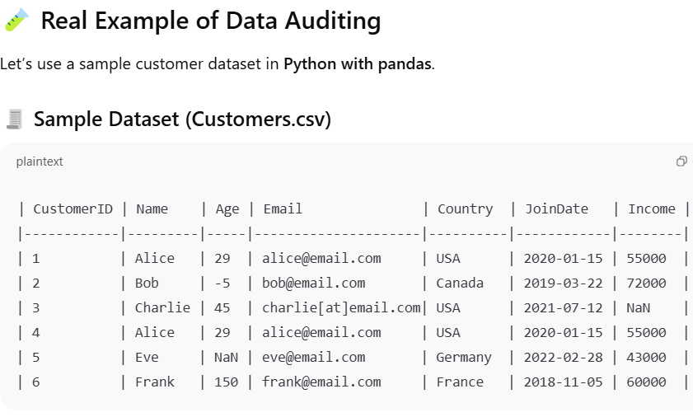
Data auditing with real example

Slide 52
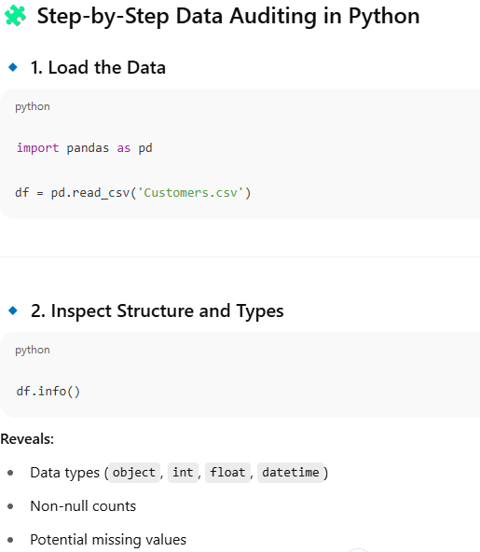
Data auditing with real example

Slide 53
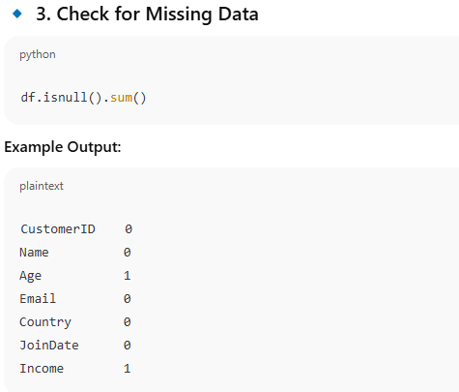
Data auditing with real example

Slide 54
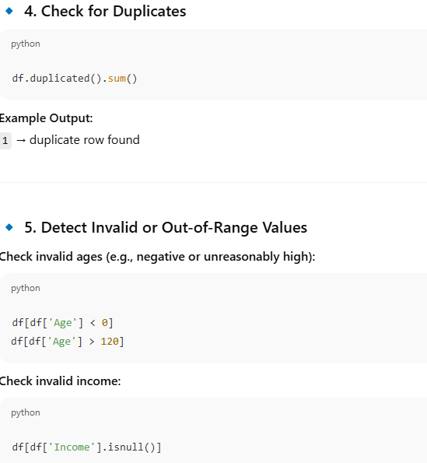
Data auditing with real example

Slide 55
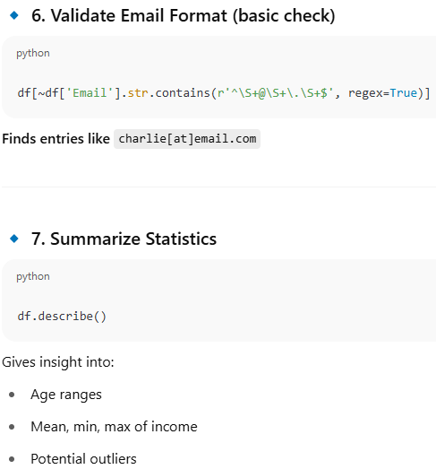
Data auditing with real example

Slide 56
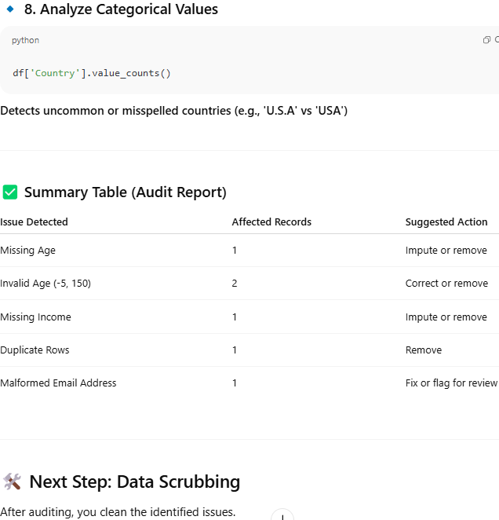
Data auditing with real example

Slide 57
Data scrubbing
Data scrubbing (also known as data cleansing or data cleaning) is the process of detecting, correcting, or removing inaccurate, incomplete, corrupted, incorrectly formatted, or duplicated data from a dataset.
It's a crucial step in data preprocessing to ensure high-quality, reliable results in data analysis, machine learning, or business intelligence.

Slide 58
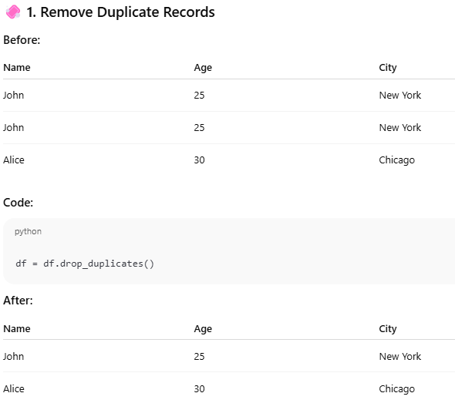
Data scrubbing

Slide 59
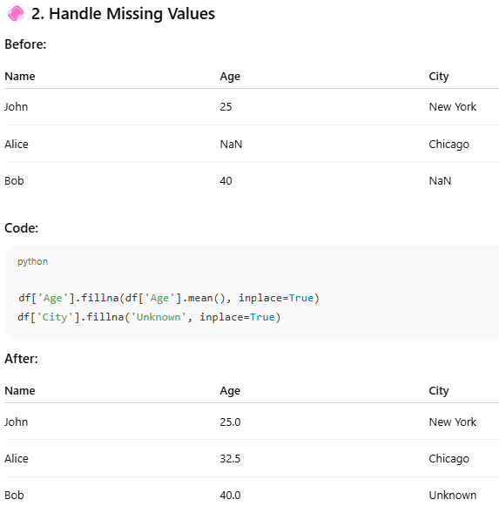
Data scrubbing

Slide 60
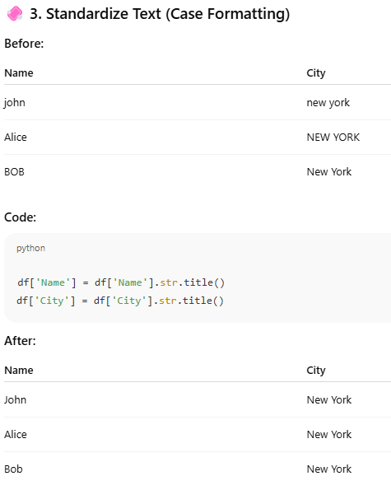
Data scrubbing

Slide 61
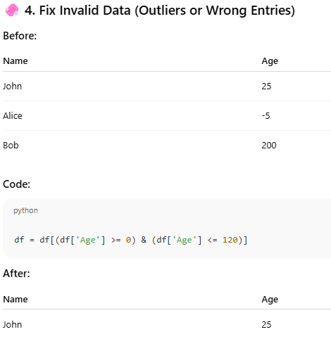
Data scrubbing

Slide 62
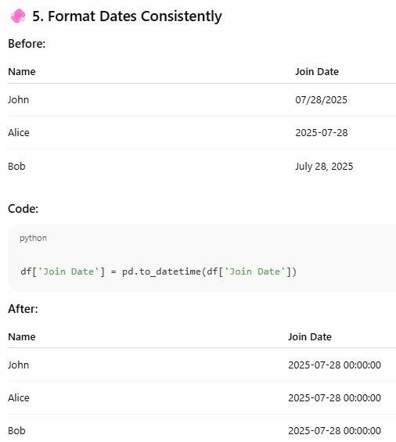
Data scrubbing

Slide 63
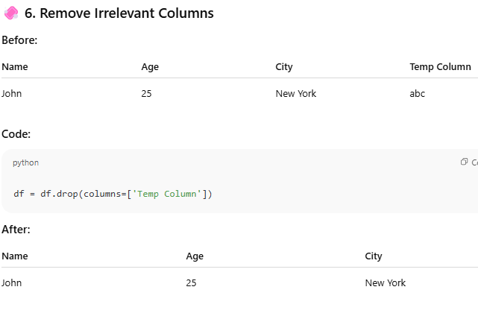
Data scrubbing

Slide 64

Correlation Analysis (Nominal Data)
Χ² (chi-square) test
The larger the Χ² value, the more likely the variables are related
The cells that contribute the most to the Χ² value are those whose actual count is very different from the expected count

Slide 65
Correlation Analysis (Nominal Data)
Correlation does not imply causality (পরোক্ষভাবে প্রকাশ করা
কারণতা)
  # of hospitals and # of car-theft in a city are correlated
  Both are causally linked to the third variable: population
if A and B are correlated, this does not necessarily imply that A causes B or that B causes A.
  For example, in analyzing a demographic database, we may find that attributes representing the number of hospitals and the number of car thefts in a region are correlated.
This does not mean that one causes the other. Both are actually causally linked to a third attribute, namely, population.

Slide 66
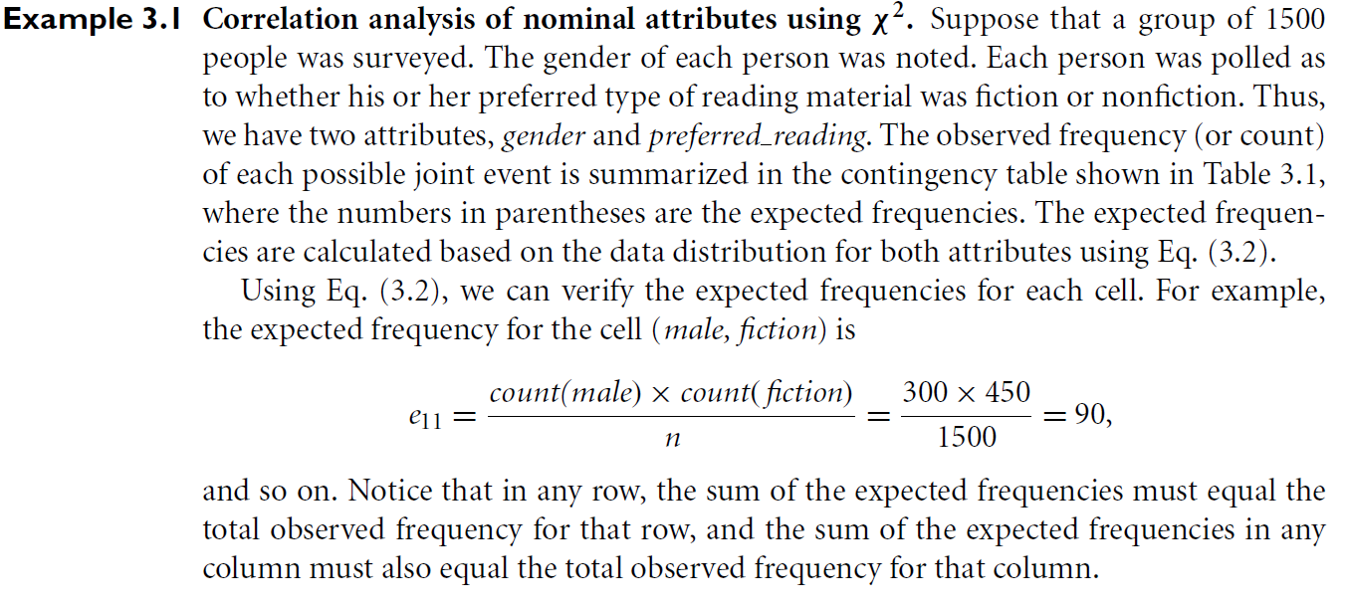
Chi-Square Calculation: An Example

Slide 67
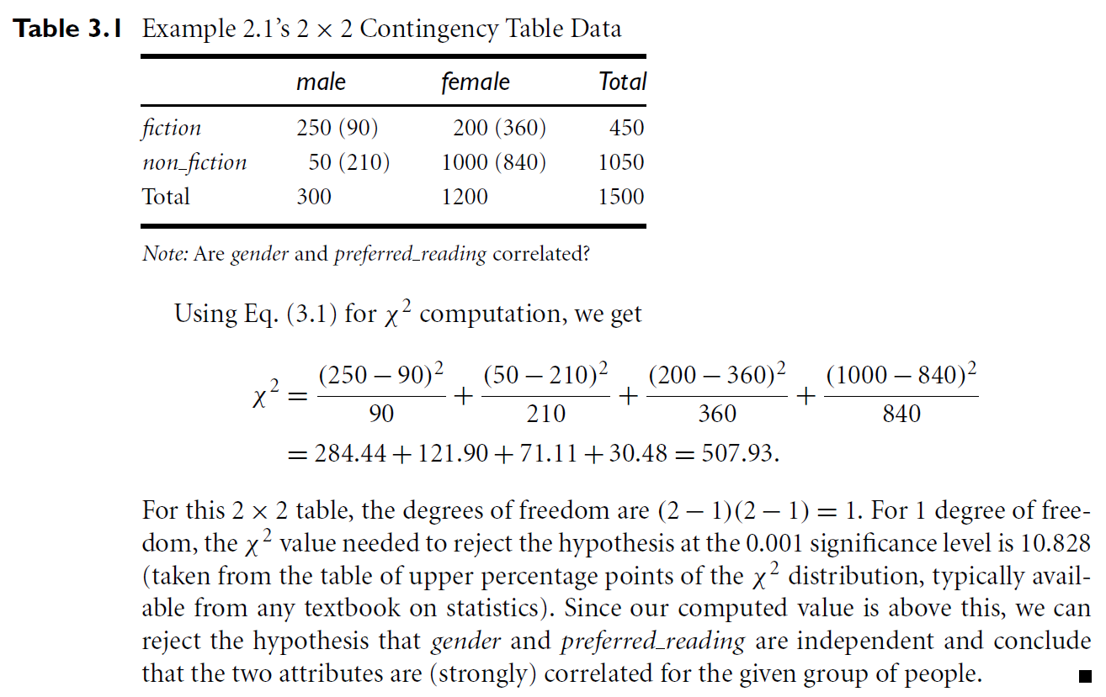
Chi-Square Calculation: An Example

Slide 68
Chi-Square Calculation: An Example
Χ² (chi-square) calculation (numbers in parenthesis are expected counts calculated based on the data distribution in the two categories)
It shows that like_science_fiction and play_chess are correlated in the group
 | Play chess | Not play chess | Sum (row)
Like science fiction | 250(90) | 200(360) | 450
Not like science fiction | 50(210) | 1000(840) | 1050
Sum(col.) | 300 | 1200 | 1500

Slide 69



Correlation Analysis (Numeric Data)
Correlation coefficient (also called Pearson’s product moment coefficient)
  where n is the number of tuples, and are the respective means of A and B, σ_{A} and σ_{B} are the respective standard deviation of A and B, and Σ(a_{i}b_{i}) is the sum of the AB cross-product.
If r_{A,B} > 0, A and B are positively correlated (A’s values increase as B’s). The higher, the stronger correlation.
r_{A,B} = 0: independent; r_{AB} < 0: negatively correlated

Slide 70


Covariance (Numeric Data)
In probability theory and statistics, correlation and covariance are two similar measures for assessing how much two attributes change together.
  where n is the number of tuples, and are the respective mean or expected values of A and B, σ_{A} and σ_{B} are the respective standard deviation of A and B.
Correlation coefficient:

Slide 71
Covariance (Numeric Data)
Positive covariance: If Cov_{A,B} > 0, then A and B both tend to be larger than their expected values.
Negative covariance: If Cov_{A,B} < 0 then if A is larger than its expected value, B is likely to be smaller than its expected value.
Independence: Cov_{A,B} = 0 but the converse (বিপরীত) is not true:
  Some pairs of random variables may have a covariance of 0 but are not independent.
  Only under some additional assumptions (e.g., the data follow multivariate normal distributions) does a covariance of 0 imply independence

Slide 72

Co-Variance: An Example
It can be simplified in computation as
Suppose two stocks A and B have the following values in one week: (2, 5), (3, 8), (5, 10), (4, 11), (6, 14).
Question: If the stocks are affected by the same industry trends, will their prices rise or fall together?
  E(A) = (2 + 3 + 5 + 4 + 6)/ 5 = 20/5 = 4
  E(B) = (5 + 8 + 10 + 11 + 14) /5 = 48/5 = 9.6
  Cov(A,B) = (2×5+3×8+5×10+4×11+6×14)/5 − 4 × 9.6 = 4
Thus, A and B rise together since Cov(A, B) > 0.

Slide 73





Normalization
Min-max normalization: to [new_min_{A}, new_max_{A}]
  Ex. Let income range $12,000 to $98,000 normalized to [0.0, 1.0]. Then $73,000 is mapped to
Z-score normalization (μ: mean, σ: standard deviation):
  Ex. Let μ = 54,000, σ = 16,000. Then
Normalization by decimal scaling
Where j is the smallest integer such that Max(|ν’|) < 1

Slide 74
Normalization
Normalization by decimal scaling: Normalization by decimal scaling normalizes by moving the decimal point of values of attribute A.
The number of decimal points moved depends on the maximum absolute value of A.
Decimal scaling. Suppose that the recorded values of A range from -986 to 917.
The maximum absolute value of A is 986.
To normalize by decimal scaling, we therefore divide each value by 1000 (i.e., j = 3) so that -986 normalizes to -0.986 and 917 normalizes to 0.917.

Slide 75
Attribute Subset Selection
Attribute subset selection reduces the data set size by removing irrelevant or redundant attributes (or dimensions).
The goal of attribute subset selection is to find a minimum set of attributes such that the resulting probability distribution of the data classes is as close as possible to the original distribution obtained using all attributes.
Mining on a reduced set of attributes has an additional benefit:
  It reduces the number of attributes appearing in the discovered patterns, helping to make the patterns easier to understand.

Slide 76
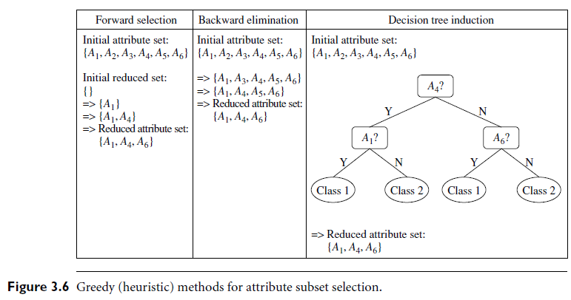
Attribute Subset Selection

Slide 77
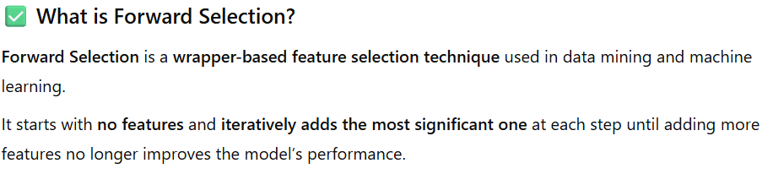
Forward Selection in Attribute Subset Selection (Feature Selection)

Slide 78

Forward Selection in Attribute Subset Selection (Feature Selection)

Slide 79

Forward Selection in Attribute Subset Selection (Feature Selection)

Slide 80

Forward Selection in Attribute Subset Selection (Feature Selection)

Slide 81

Backward Selection in Attribute Subset Selection (Feature Selection)

Slide 82

Backward Selection in Attribute Subset Selection (Feature Selection)

Slide 83

Backward Selection in Attribute Subset Selection (Feature Selection)

Slide 84

Backward Selection in Attribute Subset Selection (Feature Selection)

Slide 85
Attribute Subset Selection
1. Stepwise forward selection:
  The procedure starts with an empty set of attributes as the reduced set.
  The best of the original attributes is determined and added to the reduced set.
  At each subsequent iteration or step, the best of the remaining original attributes is added to the set.
2. Stepwise backward elimination:
  The procedure starts with the full set of attributes.
  At each step, it removes the worst attribute remaining in the set.
3. Combination of forward selection and backward elimination:
  The stepwise forward selection and backward elimination methods can be combined so that, at each step, the procedure selects the best attribute and removes the worst from among the remaining attributes.

Slide 86

Decision tree induction with real example

Slide 87

Decision tree induction with real example

Slide 88

Decision tree induction with real example

Slide 89

Decision tree induction with real example

Slide 90
Attribute Subset Selection
4. Decision tree induction:
  Decision tree algorithms (e.g., ID3, C4.5, and CART- Classification And Regression Trees for Machine Learning) were originally intended for classification.
  Decision tree induction constructs a flowchart like structure where each internal (non leaf) node denotes a test on an attribute, each branch corresponds to an outcome of the test, and each external (leaf) node denotes a class prediction.
  At each node, the algorithm chooses the “best” attribute to partition the data into individual classes.
  When decision tree induction is used for attribute subset selection, a tree is constructed from the given data.
  All attributes that do not appear in the tree are assumed to be irrelevant.

Slide 91
Histogram Analysis
Divide data into buckets and store average (sum) for each bucket
Partitioning rules:
  Equal-width: In an equal-width histogram, the width of each bucket range is uniform (e.g., the width of $10 for the buckets in Figure 3.8).
  Equal-frequency (or equal-depth): In an equal-frequency histogram, the buckets are created so that, roughly, the frequency of each bucket is constant (i.e., each bucket contains roughly the same number of contiguous data samples).

Slide 92
Histogram Analysis
Histograms use binning to approximate data distributions and are a popular form of data reduction.
A histogram for an attribute, A, partitions the data distribution of A into disjoint subsets, referred to as buckets or bins.
If each bucket represents only a single attribute–value/frequency pair, the buckets are called singleton buckets.
Often, buckets instead represent continuous ranges for the given attribute.

Slide 93
Histogram Analysis
Example 3.3 Histograms.
  The following data are a list of AllElectronics prices for commonly sold items (rounded to the nearest dollar).
  The numbers have been sorted: 1, 1, 5, 5, 5, 5, 5, 8, 8, 10, 10, 10, 10, 12, 14, 14, 14, 15, 15, 15, 15, 15, 15, 18, 18, 18, 18, 18, 18, 18, 18, 20, 20, 20, 20, 20, 20, 20, 21, 21, 21, 21, 25, 25, 25, 25, 25, 28, 28, 30, 30, 30.

Slide 94

Histogram Analysis

Slide 95

Histogram Analysis

Slide 96

Concept Hierarchy Generation in Data Mining

Slide 97

Concept Hierarchy Generation in Data Mining

Slide 98

Concept Hierarchy Generation in Data Mining

Slide 99
Concept Hierarchy Generation
Concept hierarchy organizes concepts (i.e., attribute values) hierarchically and is usually associated with each dimension in a data warehouse
Concept hierarchies facilitate drilling and rolling in data warehouses to view data in multiple granularity
Concept hierarchy formation: Recursively reduce the data by collecting and replacing low level concepts (such as numeric values for age) by higher level concepts (such as youth, adult, or senior)
Concept hierarchies can be explicitly specified by domain experts and/or data warehouse designers
Concept hierarchy can be automatically formed for both numeric and nominal data. For numeric data, use discretization methods shown.

Slide 100
Concept Hierarchy Generation for Nominal Data
Specification of a partial/total ordering of attributes explicitly at the schema level by users or experts
  street < city < state < country
Specification of a hierarchy for a set of values by explicit data grouping
  {Urbana, Champaign, Chicago} < Illinois
Automatic generation of hierarchies (or attribute levels) by the analysis of the number of distinct values
  E.g., for a set of attributes: {street, city, state, country}

Slide 101
Automatic Concept Hierarchy Generation
Some hierarchies can be automatically generated based on the analysis of the number of distinct values per attribute in the data set
  The attribute with the most distinct values is placed at the lowest level of the hierarchy
  Exceptions, e.g., weekday, month, quarter, year
country
15 distinct values
province_or_ state
365 distinct values
city
3567 distinct values
street
674,339 distinct values

Slide 102
Chapter 3: Data Preprocessing
Data Preprocessing: An Overview
  Data Quality
  Major Tasks in Data Preprocessing
Data Cleaning
Data Integration
Data Reduction
Data Transformation and Data Discretization
Summary

Slide 103
Summary
Data quality: accuracy, completeness, consistency, timeliness, believability, interpretability
Data cleaning: e.g. missing/noisy values, outliers
Data integration from multiple sources:
  Entity identification problem
  Remove redundancies
  Detect inconsistencies
Data reduction
  Dimensionality reduction
  Numerosity reduction
  Data compression
Data transformation and data discretization
  Normalization
  Concept hierarchy generation

Slide 104
References
D. P. Ballou and G. K. Tayi. Enhancing data quality in data warehouse environments. Comm. of ACM, 42:73-78, 1999
A. Bruce, D. Donoho, and H.-Y. Gao. Wavelet analysis. IEEE Spectrum, Oct 1996
T. Dasu and T. Johnson. Exploratory Data Mining and Data Cleaning. John Wiley, 2003
J. Devore and R. Peck. Statistics: The Exploration and Analysis of Data. Duxbury Press, 1997.
H. Galhardas, D. Florescu, D. Shasha, E. Simon, and C.-A. Saita. Declarative data cleaning: Language, model, and algorithms. VLDB'01
M. Hua and J. Pei. Cleaning disguised missing data: A heuristic approach. KDD'07
H. V. Jagadish, et al., Special Issue on Data Reduction Techniques. Bulletin of the Technical Committee on Data Engineering, 20(4), Dec. 1997
H. Liu and H. Motoda (eds.). Feature Extraction, Construction, and Selection: A Data Mining Perspective. Kluwer Academic, 1998
J. E. Olson. Data Quality: The Accuracy Dimension. Morgan Kaufmann, 2003
D. Pyle. Data Preparation for Data Mining. Morgan Kaufmann, 1999
V. Raman and J. Hellerstein. Potters Wheel: An Interactive Framework for Data Cleaning and Transformation, VLDB’2001
T. Redman. Data Quality: The Field Guide. Digital Press (Elsevier), 2001
R. Wang, V. Storey, and C. Firth. A framework for analysis of data quality research. IEEE Trans. Knowledge and Data Engineering, 7:623-640, 1995

